Slide 1

Computer Architecture Project 1
By- Anmol Gautam ( AXG190014)
Soumyadeep Choudhury (SXC180056)
Marks Distribution: 100/100

Slide 2
Introduction
Our project is implemented on gem5 simulator.
This project is an implementation of three different branch predictors on the above mentioned gem5 simulator.
Challenges and Issues faced during the project are explicitly stated.
Results for 5 different benchmarks are provided by running all 3 branch predictors on it.

Slide 3
Gem 5
Gem5 simulator is a platform for simulating computer system architecture. It incorporates system level architecture and processor microarchitecture.
Key Features :
Multiple CPUs sharing a common ISA architecture.
A completely coordinated GPU mode.
Integrated NoMali GPU model removes the need for software rendering.
Implemented event-driven memory system captures the impact of current and emerging memories.
A model that plays back elastic traces.
Homogenous and Heterogeneous multicore model.
Full system capacity for Alpha, ARM, SPARC and x86
Various frameworks can be launched inside a solitary reenactment process.
Gem5's items are masterminded in OS-obvious power and clock areas, empowering a scope of tests in power-and vitality proficiency.
Gem5 can be effectively ran as a thread inside system event kernel, which synchronizes events and timeline.

Slide 4
Branch Predictors
Branch expectation is a way to deal with PC design that endeavors to relieve the expenses of branches. Branch predication accelerates the handling of branch instructions with CPUs utilizing pipelining. The strategy includes possibly executing certain guidelines if certain predicates are valid. The branch forecast is normally actualized in hardware utilizing a branch indicator.
If predicted output does not matches the actual then CPU needs to execute correct branch of operation which adds extra overhead.
If predicted output is correct, extra clock cycle overhead for executing those instructions is reduced and a significant increase in speed is obtained.
Branch predictors used for our project :
Local Branch Predictor
Bi-Mode Branch Predictor
Tournament Branch Predictor

Slide 5
Challenges and Issues
To build on gem5, we had to install dependencies for which we referred to the official documentation of gem5 where required softwares and libraries are mentioned.
Installing dependencies as mentioned on our local system did not work for our machine.
This happened because in our system we are using deep learning cuda network with python 3.6 libraries for Machine Learning.
We are using cuda10.1, Python 3.6, cudnn 2.1., cross compiler is upgraded to latest version and kernel version had been upgraded to > 4.3.3. Official manual page of gem5 suggests using kernel version between 3.1.3 to 4.1.1.
Ubuntu version is 18.04.5 LTS. Libraries suggested in gem5 manual page are not directly compatible for this Ubuntu version.
To solve the above-mentioned issues, we created two instances of the kernel and installed the following files :
Softwares : SCons1, zlib1, m41, protobuf1, pydot1
Dependencies : libfdt1, dnet1, iostream3, libelf1, PLY1, x11ksyms1, fputils1

Slide 6
Challenges and Issues (contd.)
Cross compiler issue was solved by aliasing UEFI mode in boot system so that simulator can run on CPU kernel instead of GPU (default for cuda network).
Faced an issue of <boost/bind.hpp> while building gem5. This was because of kernel version issue. This was solved by reducing kernel version.
Issue faced of parsing Input arguments in benchmark files. These took string values for which appropriate changes were made in shell file.
Last thread was implicitly exiting every time. The reason for this was that the number of channels and time steps (lbm) were not synchronized.
Maximum number of threads that can run parallelly in gem5 was prespecified at a less value. Because of that gem5 was not able to execute all instructions if the total number of instructions were given a high value. Solved by increasing the maximum thread count.
Panic condition fd<0 occurred which led the failure of opening the .src/benchmark file because DRAM memory capacity usage exceeded/did not match the address range that was assigned.
CPU type in shell was given as Atomic but name convention of executable created by python libraries in gem5/build/86 is different.

Slide 7
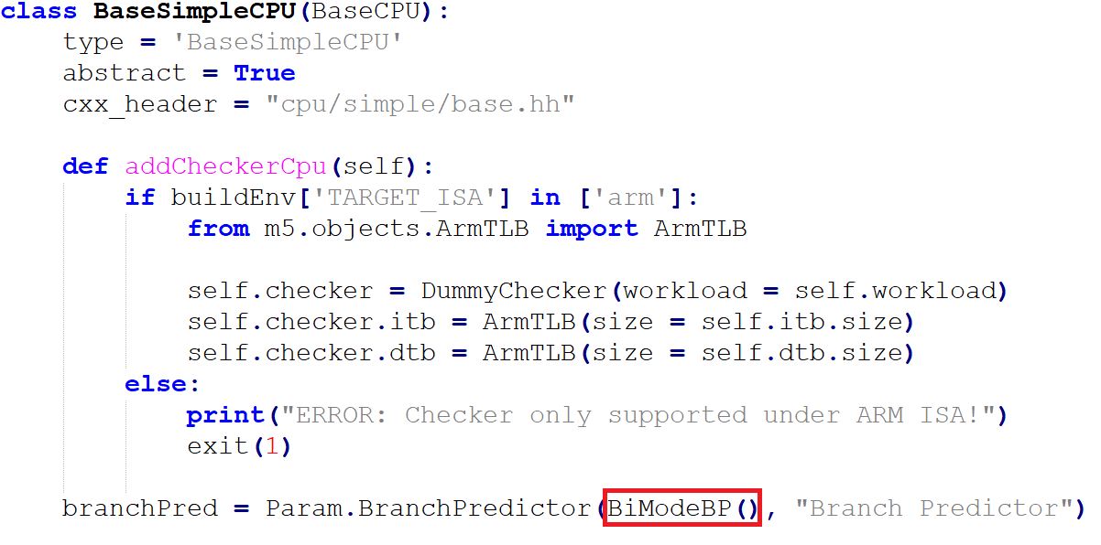
Modifications and Changes
Following are the changes and modifications made for our project
BaseSimpleCPU.py → Change NULL to branch predictor function call.

Slide 8
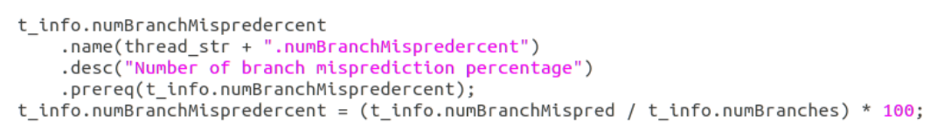
Modifications and Changes (contd.)
base.cc → Add branch miss prediction rate
exec_context.hh → Add the name used in base.cc in header file

Slide 9
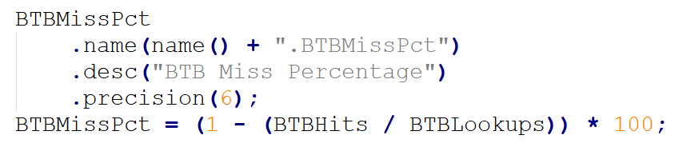
Modifications and Changes (contd.)
bpred_unit.cc → Branch Target Buffer Miss percentage.
bpred_unit.hh → Add variables used in bpred_unit.cc.

Slide 10
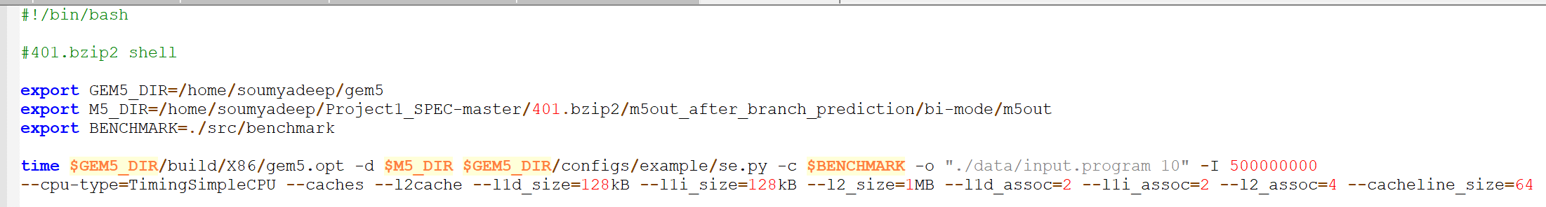
Modifications and Changes (contd.)
In BranchPredictor.py changes to size and entry numerical bound parameters were changed as suggested in Part 4 of the project description. (highlighted in yellow in project description)
Changes to shell file of each benchmark is done similar as below. This shell file is of 401.bzip2. Output location was changed for each predictor so that output is generated in different folders.

Slide 11
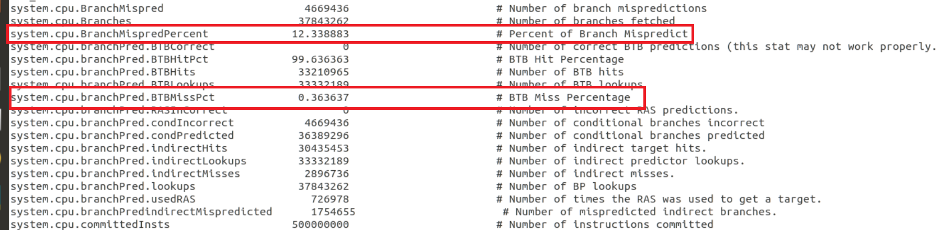
Stats File generated
Stats generated for BranchMispredPercent and BTBMissPct

Slide 12
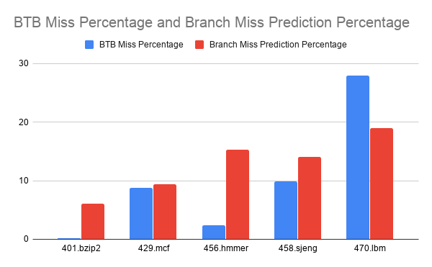
Results
Local Branch Predictor
PARAMETERS | 401.bzip2 | 429.mcf | 456.hmmer | 458.sjeng | 470.lbm
BTB Miss % | 0.183930 | 8.734989 | 2.386576 | 9.875465 | 27.932256
Branch Miss Prediction % | 6.01821 | 9.3814 | 15.286 | 14.0412 | 18.9972
L1 Data Misses | 4712756 | 10327189 | 311 | 942325 | 189
L1 Instruction Misses | 986 | 690 | 445 | 2378 | 332
L2 Cache Misses | 2938275 | 7758241 | 632 | 8175286 | 540
CPI (System) | 1.5644 | 2.4479 | 1.00125232 | 2.32793 | 1.0000968

Slide 13
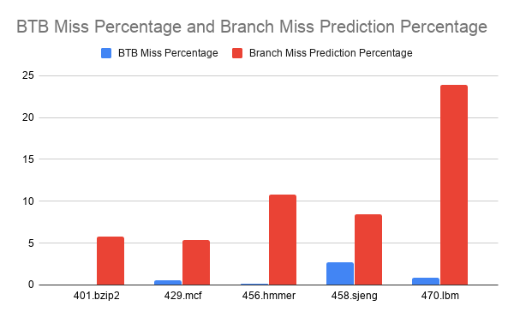
Results (contd.)
Bi-Mode Branch Predictor
PARAMETERS | 401.bzip2 | 429.mcf | 456.hmmer | 458.sjeng | 470.lbm
BTB Miss % | 0.039517 | 0.586867 | 0.162733 | 2.744171 | 0.892387
Branch Miss Prediction % | 5.76032 | 5.3886 | 10.79926 | 8.4639 | 23.86433
L1 Data Misses | 4712756 | 10327189 | 311 | 942325 | 189
L1 Instruction Misses | 986 | 690 | 445 | 2378 | 332
L2 Cache Misses | 2938271 | 7758242 | 631 | 8175283 | 540
CPI (System) | 1.5644 | 2.4477 | 1.00125234 | 2.32794 | 1.0000968

Slide 14
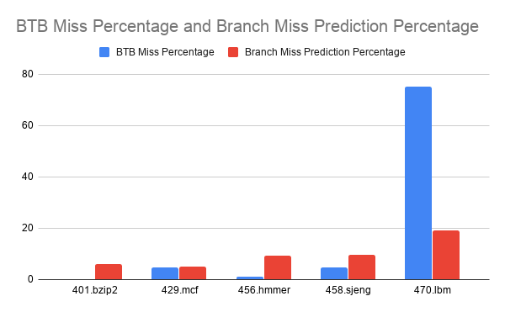
Results (contd.)
Tournament Branch Predictor
PARAMETERS | 401.bzip2 | 429.mcf | 456.hmmer | 458.sjeng | 470.lbm
BTB Miss % | 0.136522 | 4.637573 | 1.077412 | 4.773571 | 75.311463
Branch Miss Prediction % | 5.9542 | 4.97278 | 9.42718 | 9.79563 | 19.02369
L1 Data Misses | 4712654 | 10327041 | 287 | 942220 | 189
L1 Instruction Misses | 979 | 673 | 442 | 2369 | 331
L2 Cache Misses | 2931639 | 7751382 | 611 | 8175232 | 538
CPI (System) | 1.05633 | 2.4467 | 1.000772 | 2.3269 | 1.0000967

Slide 15
Results (contd.)
TYPE | Local | Global | Choice | 401.bzip2 | 429.mcf | 456.hmmer | 458.sjeng | 470.lbm
BTBM% BMiss% | 1024 | 4096 | 4096 | 0.136 5.95 | 4.637 4.972 | 1.077 9.42 | 4.77 9.79 | 75.311 19.02
BTBM% BMiss% | 1024 | 2048 | 2048 | 0.134 5.97 | 5.897 5.091 | 1.082 9.77 | 4.98 10.23 | 74.06 19.77
BTBM% BMiss% | 1024 | 2048 | 4096 | 0.140 5.96 | 4.6447 5.045 | 1.267 9.513 | 4.82 10.08 | 77.18 19.44
BTBM% BMiss% | 1024 | 2048 | 8192 | 0.141 5.94 | 4.708 5.013 | 1.78 9.578 | 4.58 9.87 | 78.25 19.38
BTBM% BMiss% | 1024 | 4096 | 2048 | 0.13 5.97 | 6.35 5.019 | 1.13 9.4 | 4.81 10.05 | 76.4545 19.4
BTBM% BMiss% | 2048 | 2048 | 8192 | 0.142 5.93 | 4.6923 4.95 | 1.08 8.36 | 7.31 14.4 | 75.89 20.63
BTBM% BMiss% | 2048 | 8192 | 8192 | 0.135 5.99 | 4.609 4.804 | 0.367 8.078 | 4.61 9.24 | 69.87 18.94
BTBM% BMiss% | 2048 | 2048 | 2048 | 0.129 5.96 | 6.68 5.03 | 0.87 8.521 | 5.77 12.82 | 71.45 19.998
BTBM% BMiss% | 2048 | 2048 | 4096 | 0.139 5.95 | 4.605 4.977 | 1.793 8.42 | 4.74 9.78 | 77.86 19.13
BTBM% BMiss% | 2048 | 4096 | 8192 | 0.1395 5.92 | 4.87 4.705 | 1.0378 8.15 | 4.51 9.41 | 75.107 19.07
As suggested in project description, sizes of local, branch and choice predictors are varied in the tournament predictor is varied and the resulting Branch Target Miss Percentage(BTBM%) and Branch misprediction percentage (Bmiss%) are mentioned explicitly in the table.

Slide 16
Conclusion
With the increase in buffer size we observe that the branch misprediction rate is decreasing more in comparison to the change in BTB miss. This is because if size of the local and global predictors are increased then we can store more combinations of pattern history and it will lead to better results due to spatial and temporal locality.
Also it was observed that tournament predictor works better than the other two predictors in most of the cases.

Slide 17

THANK YOU

